Slide 1

SACRAMENTO COUNTY HEALTH AUTHORITY COMMISSION
Medi-Cal Redeterminations,
Medi-Medi Plans
March 19, 2024

Slide 2
Agenda Item 1:
Welcome/Opening Remarks
& Updates

Slide 3
Agenda
Welcome/Opening Remarks & Updates
Agenda Review, New Member Introductions, and Updates
Presentation & Discussion: Commission Attendance
Presentation, Discussion & Action: Medi-Cal Redeterminations Update & Commission Letter to Board of Supervisors
Presentation, Discussion & Action: Medi-Medi Plans for Dual Eligible Members
Discussion: Topics of Interest for Future Meetings
Public Comment
Closing Comments & Adjournment

Slide 4
Agenda Item 2:
Agenda Review, New Member Introductions, and Updates

Slide 5
Agenda Item 3:
Presentation & Discussion: Commission Attendance

Slide 6
Agenda Item 4:
Presentation and Discussion: Medi-Cal Redeterminations Update & Commission Letter to Board of Supervisors

Slide 7
Medi-Cal Continuous Coverage Unwinding Dashboard
January 2024
Data provided by the Department of Health Care Services, and available for viewing at Continuous-Coverage-Eligibility-Unwinding-Dashboard-October2023 (ca.gov)

Slide 8
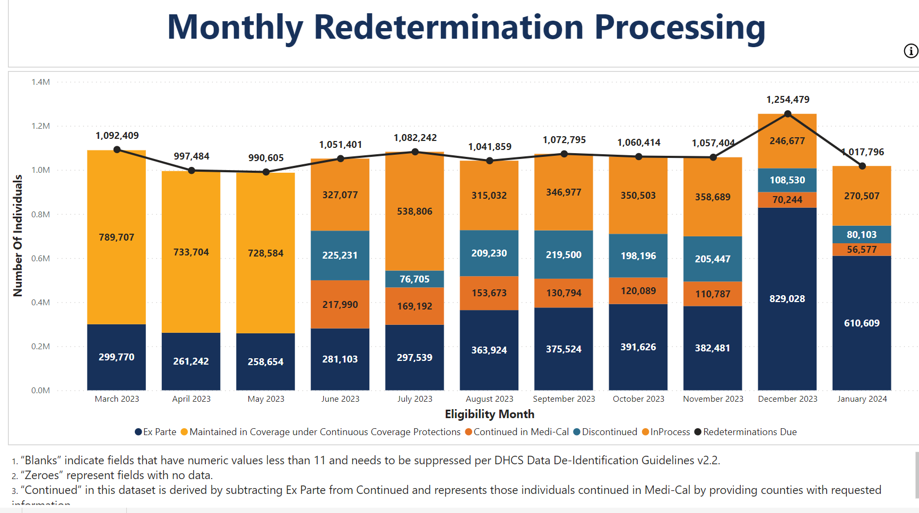
Statewide Data:

Slide 9
Monthly Redetermination Processing:
Statewide & County Comparison

Slide 10
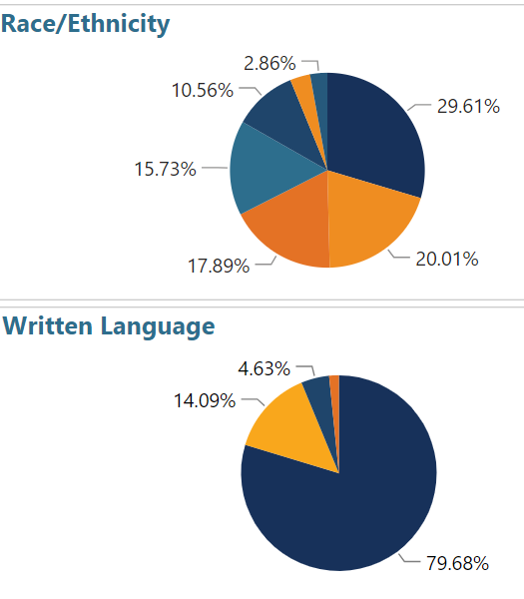
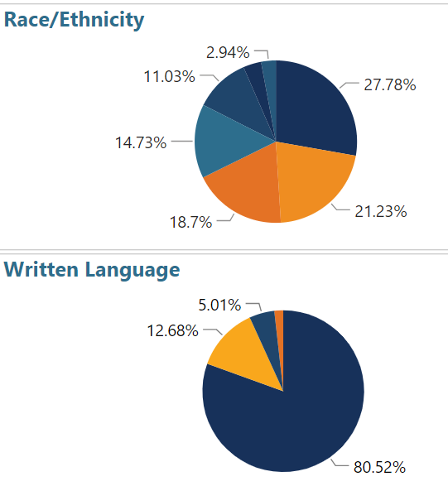
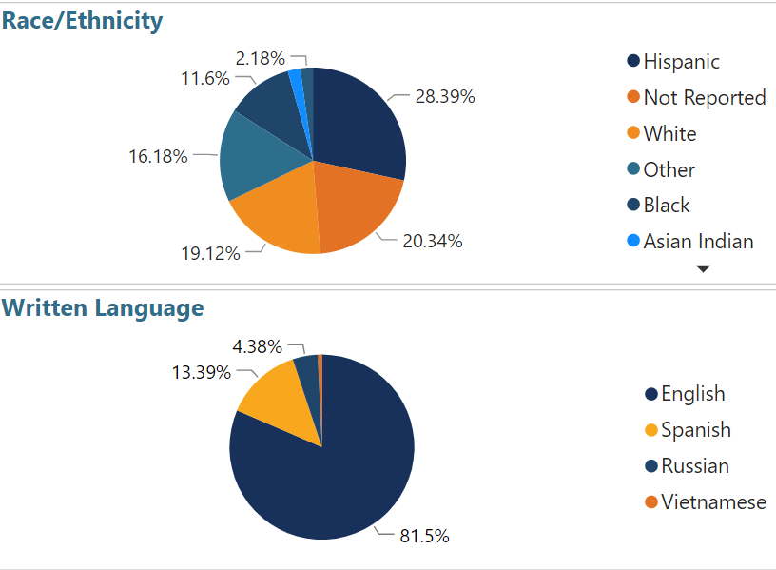
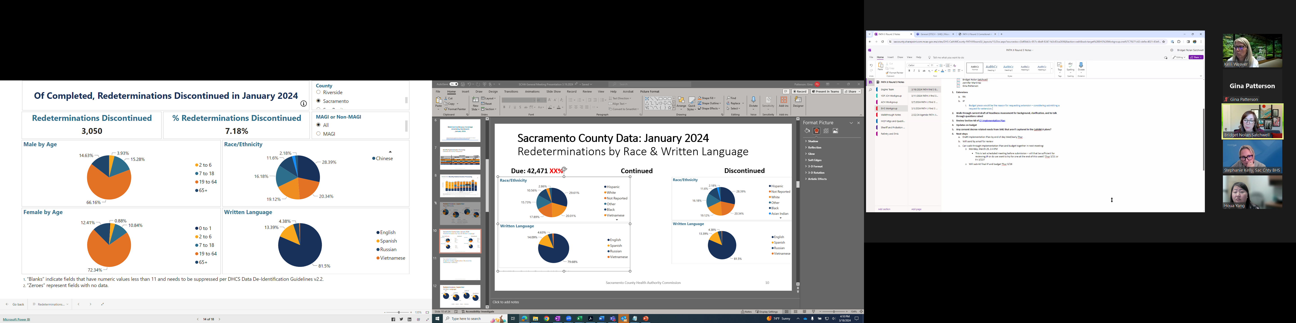
Sacramento County Data: January 2024
Redeterminations by Race & Written Language
Due: 42,471
Continued: 25,209
Discontinued: 3,050 (7.18%)

Slide 11
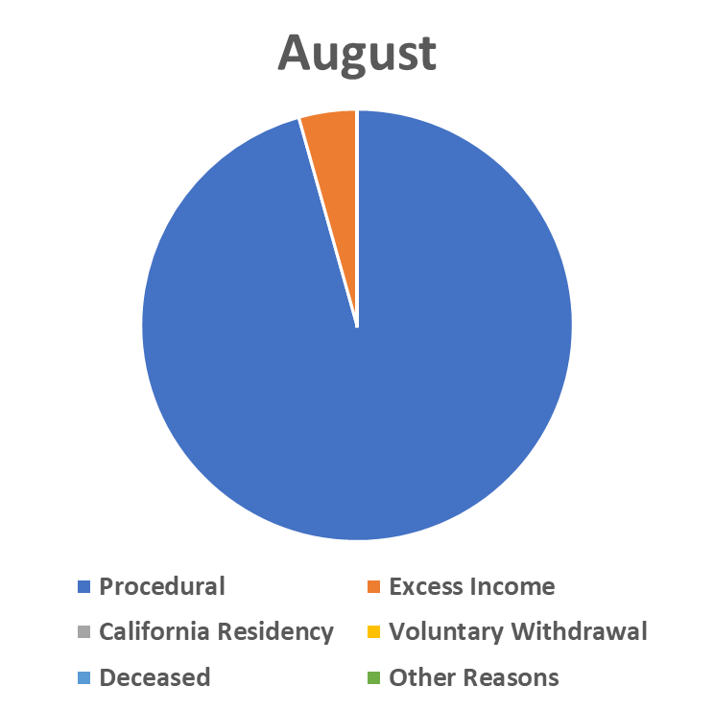
County-level Discontinuance Reasons:
Comparison |October data last reviewed in January commission meeting
Total Discontinuances: 8,870
88.87% procedural
7,913
86.8%
Total Discontinuances: 3,025
79.69% procedural
8,013
95.6%
Notes:
Reason July Aug Sept
Procedural 7777 8013 7913
Excess Income 403 364 391
CA Residency 0 0 0
Vol.Withdrawal 297 0 246
Deceased 0 71
Other Reasons 570 0 495
Total 9047 8377 9116

Slide 12
Statewide Procedural Disenrollment Survey
The individuals surveyed in the Procedural Disenrollment Survey does not include the individuals that were determined ineligible because they have requested discontinuance from Medi-Cal or were determined ineligible for Medi-Cal on other basis.
  Survey Month 2 Survey Month 1 Survey Questions
Month 2 Key Findings (State-wide data)
• About one-third of all survey respondents (32%) said they did not know they would lose Medi-Cal if they failed to complete their renewal.
• Nearly four in ten (38%) of all respondents said they would like to restart Medi-Cal but did not know how.
• Nearly half of all survey respondents (46%) said they did not receive a renewal form.
• Of those who received a renewal form, six in ten respondents (60%) reported completing it.
• Of those who received a renewal form and completed or tried to complete it, about one-third (32%) said that they called but got no answer, were on hold too long, or got disconnected.
• Respondents who live in households whose members all identify as Hispanic were significantly more likely to experience some challenges compared to other households.
Medi-Cal Eligibility Statistics

Slide 13
Review Letter to Board of Supervisors
Link to document

Slide 14
Medi-Medi Plans in Sacramento County
Agenda Item 5:
Presentation for the
Sacramento County Health Authority Commission
March 19, 2024

Slide 15
Agenda
Overview: Dual Eligible Beneficiaries
Medicare Medi-Cal Plans (Medi-Medi Plans)
Resources

Slide 16
Overview: Dual Eligible Beneficiaries

Slide 17
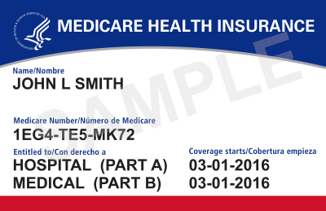
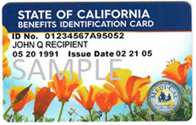
Medicare and Medi-Cal
Some people have both Medicare and Medi-Cal, known as dual eligibles (Medi-Medis).
Medicare covers doctor visits, hospital stays, labs, prescription drugs, and other benefits.
Medi-Cal covers Medicare Part B premiums, copays, adult day health care, skilled nursing facility care, dental, and In-Home Supportive Services (IHSS).

Slide 18
Dual Eligible Beneficiaries
Nationally, dual eligible beneficiaries are more likely than people with Medicare only to report being in poor health (13% vs. 4%).
  Heart failure, hypertension, depression diagnoses among dual eligible beneficiaries occur at significantly higher rates than in Medicare-only population.
Dual Eligible beneficiaries have high rates of chronic conditions, high utilization, and are a diverse group:
  25% under age 65
  33% limited English proficiency
  About 18% prevalence of dementia
Over 75% of In-Home Supportive Services (IHSS) recipients and 80% of long-term Medi-Cal Skilled Nursing Facility (SNF) residents are dually eligible.

Slide 19
Dual Eligible Beneficiaries in California
In California, almost a quarter of Medicare beneficiaries also have Medi-Cal (1.6 million Californians).
  About 45% of dual eligible beneficiaries are enrolled in some type of Medicare Advantage (MA) plan, including integrated plans, and 55% are in Original (Fee-For-Service) Medicare.
All dual eligible beneficiaries in California are enrolled in Medi-Cal managed care plans.

Slide 20
Medicare Delivery System Enrollment for 1.7 million Dual Eligibles in California (October 2023)
Notes:
[Anastasia Dodson]

Slide 21
January 2024 Medi-Medi Plan Enrollment (Preliminary)
According to data published by the Centers for Medicare & Medicaid Services (CMS) January 2024 enrollment in Medi-Medi Plans is approximately 293,000.
This is an increase of approximately 48,000 from October 2023.

Slide 22
Dual Eligible Beneficiaries in
Sacramento County
In Sacramento County, about 27% of Medicare beneficiaries are dually eligible and 47% of these dual eligible beneficiaries are enrolled in some type of Medicare Advantage plan.
As of October 2023, there were about 73,000 dual eligible beneficiaries in Sacramento County.
  35,500 of these beneficiaries were in Medicare Advantage, including Dual Eligible Special Needs Plans (D-SNPs) and the Program of All-Inclusive Care for the Elderly (PACE).
As of February 2024, a total of 23,800 members are enrolled in Medi-Medi Plans in Sacramento County.
  Anthem Full Dual Advantage Aligned: 7,500 enrollees
  Kaiser Permanente Senior Advantage Medicare Medi-Cal North P2: 13,500 enrollees
  ​Wellcare Dual Align: 2,800 enrollees

Slide 23
Questions?

Slide 24
Medicare Medi-Cal Plans
(Medi-Medi Plans)

Slide 25
The Need for Coordinated Care
For most dual eligible beneficiaries, Medicare and Medi-Cal operate separately, with different funding streams.
This fragmented system can be confusing and hard to navigate. It may not provide person-centered services.
CalAIM Approach: Health plan to coordinate care across Medicare and Medi-Cal – Medicare Medi-Cal Plans (or Medi-Medi Plans)
  Available in twelve counties in 2024: Fresno, Kings, Los Angeles, Madera, Orange, Riverside, Sacramento, San Bernardino, San Diego, San Mateo, Santa Clara, and Tulare.
  Will launch in other counties by 2026.

Slide 26
Medi-Medi Plans
Medicare Medi-Cal Plans (Medi-Medi Plans) are a type of Medicare Advantage plan in California that are only available to dual eligible beneficiaries.
Beneficiaries enrolled in a Medi-Medi Plan receive their Medicare benefits through a Dual Eligible Special Needs Plan (D-SNP) and their Medi-Cal benefits through a Medi-Cal managed care plan (MCP).
D-SNP + MCP
Medi-Medi Plan
D-SNPs provide Medicare services, such as:
Hospitals
Providers
Prescription drugs
MCPs provide wrap-around services, such as:
Medicare cost-sharing
Long-Term Services and Supports (LTSS)
Transportation

Slide 27
Medi-Medi Plans in California
The program name “Medicare Medi-Cal Plans” is used by DHCS, Health Care Options (HCO), and in beneficiary notices.
  Health plans may use their own marketing name, such as in plan-specific member materials.
Medi-Medi Plans are described as a single plan in beneficiary-facing materials, as members will receive one card, one welcome packet, and have one phone number to call for member services.
Fact sheets for members and providers as well as other resources are posted on the DHCS Medi-Medi Plan website.
A list of 2024 Medi-Medi Plans by county is also available on the DHCS website.

Slide 28
Care Coordination in
Medi-Medi Plans
Physicians
Hospitals
Medi-Medi Plans help beneficiaries with all their health care needs and coordinate benefits and care, including carved-out benefits, medical and home and community-based services, durable medical equipment, and prescriptions.
Rx &
Pharmacies
Dental
Mental
Health
Labs &
X-rays
Nursing Facilities
Medical
Transport
Long-Term Services & Supports
Durable
Medical Equipment

Slide 29
Coordination with Related Medi-Cal Benefits
Medi-Medi Plans are required to coordinate all Medicare and Medi-Cal benefits, including “carved-out” benefits such as:
  In-Home Supportive Services (IHSS)
  Multipurpose Senior Services Program (MSSP)
  Specialty Mental Health and Substance Use Disorder Services provided by the county
  Medi-Cal Dental (including Dental Managed Care Plans)
Joining a Medi-Medi Plan will not impact a beneficiary’s IHSS benefits.
  Beneficiaries can keep their IHSS providers and hours.
  Beneficiaries still retain the right to hire, fire, and manage their IHSS providers.
Dual eligible beneficiaries in Medi-Medi Plans are also eligible for Community Supports provided by their Medi-Cal MCP, and Enhanced Care Management-like services from their D-SNP.

Slide 30


Medi-Medi Plans Support Access to Providers
Provider Network
  Beneficiaries will have access to a provider network through their Medi-Medi Plan.
  If a beneficiary’s provider is not in network, a provider can join the Medi-Medi Plan’s network or the Medi-Medi Plan will help the beneficiary find a new doctor they like.
  To join a Medi-Medi Plan network, a provider should contact the plan’s provider relations department directly.
Continuity of Care
  If a provider is not currently in network, there is a continuity of care period, where
  the beneficiary can continue to see their provider for up to 12 months (in most cases).
  The beneficiary must have a prior relationship with the provider, and the provider and health plan must agree to terms, including payment terms.

Slide 31
Medicare Network Adequacy Requirements
Medicare Advantage (MA) plans, including Medi-Medi Plans, must maintain a network of appropriate providers that is sufficient to provide adequate access to covered services to meet the needs of the population served.
CMS reviews and monitors Medicare provider networks and Medicare network adequacy.
CMS network adequacy requirements are at the contract level, not the sub-network (e.g., delegation) level.
Medicare Advantage Network Guidance is available on the CMS website.
If any concerns come up about Medicare network access and adequacy for a particular Medi-Medi Plan, please contact the plan first. For further escalation, please contact the CMS Regional Office at ROSFOORA@cms.hhs.gov.

Slide 32
Medicare Sub-Network Requirements
The CMS Medicare Advantage Network Guidance includes language on sub-networks (Section 5.3).
A sub-network occurs when the network provider group guides enrollee access to providers/facilities.
Each provider group furnishes primary care and may furnish specialty and institutional care.
  For example, a plan with sub-networks has more than one provider group, and referrals by an enrollee’s primary care provider (PCP) are typically made to providers/facilities in the same group.
A plan with sub-networks must allow enrollees to access all providers/facilities in the CMS-approved network for the plan’s service area; that is, the enrollees may not be “locked-in” to the sub-network.
  If an enrollee wants to see a specialist within their plan's overall network, but that is outside of the referral pattern of their current PCP in a sub-network, then the plan can require the enrollee to select a PCP that can refer the enrollee to their preferred specialist. However, each plan must ensure that it has a network that meets current CMS network adequacy criteria.

Slide 33
Joining a Medi-Medi Plan
Beneficiaries can join a
Medi-Medi Plan ​​if they:
​Have both Medicare Part A and B and Medi-Cal
Are 21 years or older
Live in one of the counties that offers Medi-Medi Plans
Beneficiary enrollment in Medi-Medi Plans is voluntary.
To enroll, a beneficiary can contact their Medi-Cal plan or
1-800-MEDICARE.

Slide 34
Medi-Cal Matching Plan Policy

Slide 35
Medi-Cal Matching Plan Policy
In 17 counties, dual eligible beneficiaries who are enrolled in a Medicare Advantage plan must be enrolled in the matching Medi-Cal managed care plan if a matching plan is available.
  The Medi-Cal Matching Plan counties are: Alameda, Contra Costa, Fresno, Kern, Kings, Los Angeles, Madera, Orange, Riverside, Sacramento, San Bernardino, San Diego, San Francisco, San Mateo, Santa Clara, Stanislaus, and Tulare.
Medicare is the lead plan, meaning a member’s Medicare plan choice determines their Medi-Cal plan.

Slide 36
2024 Options for Dual Eligible Beneficiaries in Sacramento

Slide 37
Options for Dual Eligible Beneficiaries in Sacramento County
A dual eligible beneficiary could have the following choices in 2024 in Sacramento County:
  Original Medicare and any Medi-Cal plan
  A Medi-Medi Plan
  A Medicare Advantage plan, with automatic enrollment in their matching Medi-Cal plan, if one is available
  A Medicare Advantage plan and any Medi-Cal plan, if the Medicare Advantage plan does not have a matching Medi-Cal plan
  Program of All-Inclusive Care for the Elderly (PACE)

Slide 38
Integrated Care Options in
Sacramento County
Medi-Medi Plans
Anthem Full Dual Advantage Aligned (HMO D-SNP) ​
Kaiser Permanente Senior Advantage Medicare Medi-Cal North P2 (HMO D-SNP)
Wellcare Dual Align (HMO D-SNP)
PACE
InnovAge PACE
Sutter SeniorCare PACE

Slide 39
Questions?

Slide 40
Intersections: PACE and Long-Term Care

Slide 41
Medi-Medi Plans and PACE
PACE is a different type of integrated care option for dual eligible beneficiaries who meet PACE’s eligibility criteria.
  PACE covers Medicare and Medi-Cal benefits, including prescription drugs, and can help coordinate healthcare, homecare, transportation, and dental care.
A dual eligible beneficiary cannot be enrolled in a Medi-Medi Plan and PACE at the same time.
For more information about PACE, visit CalPACE.org.

Slide 42
Medi-Cal MCPs and Long-Term Care
Under CalAIM, DHCS transitioned institutional Long-Term Care (LTC) benefits from Fee-For-Service to Medi-Cal Managed Care Plans. All MCPs are now responsible for the full LTC benefit at the following facility types and homes:
  Skilled Nursing Facilities (SNF), both freestanding and hospital-based;
  Intermediate Care Facility for Developmentally Disabled (ICF/DD) Home;
  Intermediate Care Facility for the Developmentally Disabled –​ Habilitative (ICF/DD-H) Home;
  Intermediate Care Facility for the Developmentally Disabled – Nursing (ICF/DD-N) Home;
  Subacute Care Facility and;
  Pediatric Subacute Care Facility.​
DHCS also requires non-dual and dual LTC Members receiving LTC services (including those with a Share of Cost) to be enrolled in an MCP.

Slide 43
Medi-Medi Plans and Long-Term Care
About 74 percent of SNF residents are dual eligible members.
Members with complex needs require comprehensive care management, particularly during transitions of care between a hospital and a SNF or during transitions back to their home and community.
Medi-Medi Plans offer robust care management for members in institutional settings and provide a broad array of services for Members in LTC homes/facilities, including services to residents who may be able to transition to a home or community-based setting.
Medi-Medi Plans offer more integrated systems of care and can better coordinate all services a Member in an LTC home/facility may need, such as Durable Medical Equipment (DME) and transportation to medical appointments.

Slide 44
Questions?

Slide 45
Resources

Slide 46
Resources for Providers
To learn more about Medi-Medi Plans, providers can:
  Visit the DHCS Medi-Medi Plan Webpage
  View the Medi-Medi Plans: Information for Providers Fact Sheet
Crossover Billing
  Many Medicare providers may have questions about how to bill for dual eligible beneficiaries enrolled in Medi-Cal managed care. DHCS prepared a Crossover Billing Toolkit to address these questions.
Balance Billing
  Medicare providers cannot bill dual eligible beneficiaries for Medicare Part A and B cost sharing. This is known as balance billing, or “improper billing,” and is illegal under both federal and state law. Dual eligible beneficiaries may still have a small copay for prescription drugs. Additional information is available on the DHCS website.

Slide 47
Resources for Beneficiaries
Dual eligible beneficiaries can learn more about Medi-Medi Plans by viewing the Medi-Medi Plan Fact Sheet on the DHCS Medi-Medi Plan Webpage.
  The fact sheet is available in English, Spanish, Hmong, Vietnamese, Traditional Chinese/Cantonese, Russian, Khmer/Cambodian, Arabic, Farsi, American Sign Language, and Mexican Sign Language.
To change Medicare plans, a beneficiary can contact the health plan of their choice directly or call 1-800-Medicare.
For support, beneficiaries can contact:
  Health Insurance Counseling and Advocacy Program (HICAP) for free counseling on health care options: 1-800-434-0222
  Medicare Medi-Cal Ombudsman Program for help resolving issues with providers or health plans: 1-855-501-3077

Slide 48
Additional Resources
For more information about coordinated care for dual eligibles, visit the DHCS Integrated Care for Dual Eligible Beneficiaries Website.
To learn more about D-SNPs, visit the DHCS D-SNPs in California Website.
Join the next MLTSS and Duals Integration Stakeholder Workgroup: Thursday, May 30 at 10:00 a.m.
If you have any questions, contact us at info@calduals.org.

Slide 49
Questions and Discussion

Slide 50
Agenda Item 7:
Public Comment

Slide 51
Agenda Item 8:
Closing Comments & Adjournment

Slide 52
Appendix

Slide 53
California Department of Health Services (DHCS) Continuous Coverage Unwinding Dashboard
Statewide Data

Slide 54
Medi-Cal Transition – Policy Guide
The attached 2024 Medi-Cal Managed Care Plan (MCP) Transition Policy Guide has been updated with the new Continuity of Care Data Sharing Policy and updates to sections previously released. Please use the attachment while we post the updated Policy Guide to the DHCS website.
The Policy Guide includes DHCS policy and Medi-Cal MCP requirements related to member transitions among MCPs that take effect on January 1, 2024. Updates from previous versions are reflected with highlights and strikethroughs to facilitate MCP and stakeholder tracking of the changes. The Policy Guide will be updated throughout calendar year 2023 to keep MCPs informed of new and developing guidance.

Slide 55
Key Updates to Policy Guide
Member Enrollment and Noticing – Changes to noticing required for members enrolled in a Kaiser subcontract transitioning to Kaiser prime membership
Continuity of Care – Changes include:
  Extension of some Continuity of Care protections to 6 months
  Clarification of Special Population members with authorizations to receive Enhanced Care Management services and Community Supports
  Addition of members who are residing in Intermediate Care Facilities for individuals with Developmental Disabilities (ICF/DD) to Special Populations
  Addition of Intermediate Care Facilities for individuals with Developmental Disabilities (ICF/DD) to provider types eligible for Continuity of Care for providers
  Addition of language to address inpatient billing responsibilities among Previous and Receiving MCPs
Enhanced Care Management and Community Supports Transition Policies – Updates to align with the ECM and Community Supports Policy Guides
Appendix – County Level MCP Transitions to reflect the changes to noticing required for members enrolled in a Kaiser subcontract transitioning to Kaiser prime membership

Slide 56
New Continuity of Care Data Sharing Policy
The new section on Continuity of Care data sharing is final policy. DHCS requests Managed Care Plan feedback on four attached templates as well as the file format and transmission method of data compiled according to these templates (see Section VIII):
Continuity of Care (CoC) Data Template - 1) Data Elements for All Members
Continuity of Care (CoC) Data Template - 2a) Special Populations Specifications
Continuity of Care (CoC) Data Template – 2b) Special Population Member File
Continuity of Care (CoC) Data Template – 2c) Special Populations Accompanying Data
Please note: The companion All Plan Letter (APL) 23-018 establishes the binding nature of the policy guide as the DHCS authority specific to the 2024 MCP transition and remains unchanged.

Slide 57
Unwinding Redeterminations Toolkit Materials

Slide 58
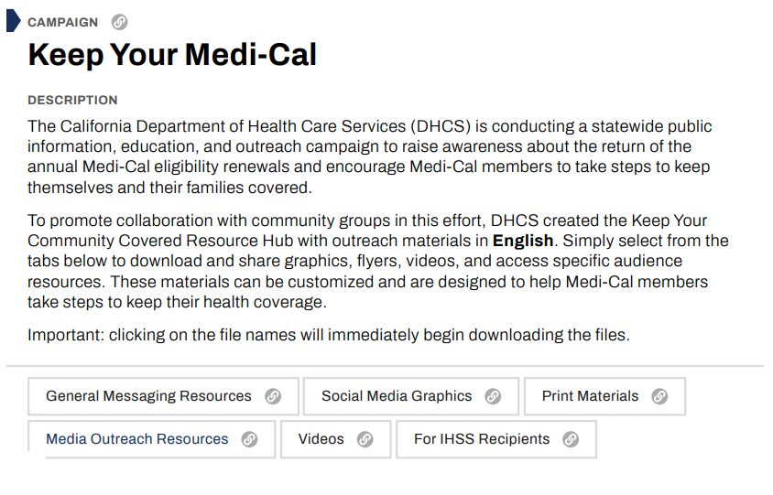
From DHCS Website
Notes:
This is primarily a resource slide
This is from the DHCS website and is available for your organization to pull assets and resources and materials from to help with outreach and education

Slide 59
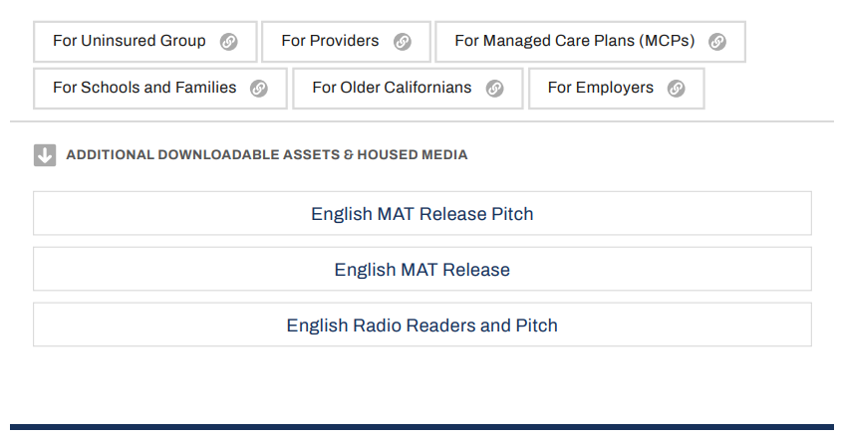
From DHCS Website
Notes:
Looking at the website materials, they have materials by provider type and populations of focus

