Slide 1

SACRAMENTO COUNTY HEALTH AUTHORITY COMMISSION
Medi-Cal Redeterminations, Annual Report, Consultant Request for Proposals (RFP)
November 27, 2023

Slide 2
Agenda Item 1:
Welcome/Opening Remarks

Slide 3
Agenda
Welcome/Opening Remarks
Agenda Review, New Member Introductions, and Updates
Presentation & Discussion: Medi-Cal Redeterminations Update
Presentation, Discussion and Action: 2023 Annual Report
Presentation, Discussion and Action: Request for Proposal (RFP) for a Consultant
Public Comment
Closing Comments & Adjournment

Slide 4
Agenda Item 2:
Agenda Review, New Member Introductions, and Updates

Slide 5
Agenda Item 3:
Presentation and Discussion: Medi-Cal Redeterminations Update

Slide 6
Medi-Cal Continuous Coverage Unwinding Dashboard
August & September 2023
Data provided by the Department of Health Care Services, and available for viewing at Continuous-Coverage-Eligibility-Unwinding-Dashboard-September2023 (ca.gov)

Slide 7
Monthly Redetermination Processing: Statewide & County Comparison

Slide 8
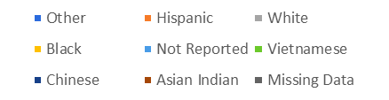
Redetermination: September Race/Ethnicity

Slide 9
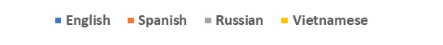
Redetermination: September Written Language
2%
1%
4%
1%
3%
4%
12%
9%
15%
82%
84%
86%
81%

Slide 10
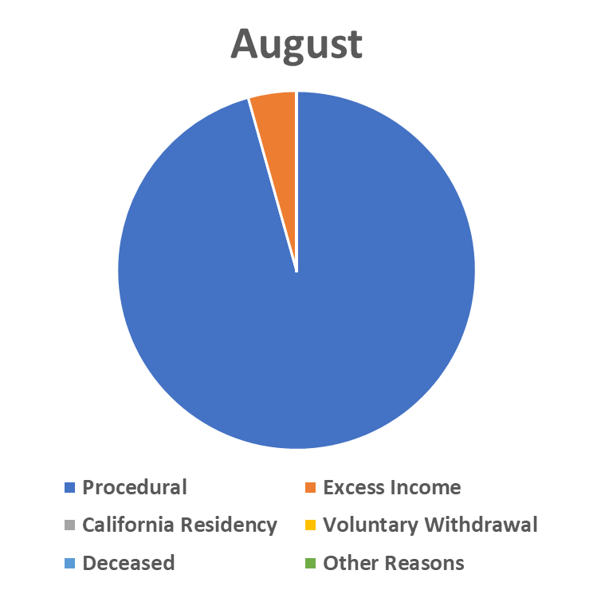
County-level Discontinuance Reasons: 3-month Comparison
7,913
86.8%
7,777 85.9%
8,013
95.6%
Notes:
Reason July Aug Sept Procedural 7777 8013 7913 Excess Income 403 364 391 CA Residency 0 0 0 Vol.Withdrawal 297 0 246 Deceased 0 71 Other Reasons 570 0 495 Total 9047 8377 9116

Slide 11
Agenda Item 4:
Review 2023 Annual Report Draft

Slide 12
Agenda Item 5:
Presentation, Discussion and Action: Consumer Protection Committee Consultant Request for Proposal (RFP)

Slide 13
Agenda Item 6:
Public Comment

Slide 14
Appendix

Slide 15
California Department of Health Services (DHCS) Continuous Coverage Unwinding Dashboard Statewide Data

Slide 16
Medi-Cal Transition – Policy Guide
The attached 2024 Medi-Cal Managed Care Plan (MCP) Transition Policy Guide has been updated with the new Continuity of Care Data Sharing Policy and updates to sections previously released. Please use the attachment while we post the updated Policy Guide to the DHCS website.
The Policy Guide includes DHCS policy and Medi-Cal MCP requirements related to member transitions among MCPs that take effect on January 1, 2024. Updates from previous versions are reflected with highlights and strikethroughs to facilitate MCP and stakeholder tracking of the changes. The Policy Guide will be updated throughout calendar year 2023 to keep MCPs informed of new and developing guidance.

Slide 17
Key Updates to Policy Guide
Member Enrollment and Noticing – Changes to noticing required for members enrolled in a Kaiser subcontract transitioning to Kaiser prime membership
Continuity of Care – Changes include:
Extension of some Continuity of Care protections to 6 months
Clarification of Special Population members with authorizations to receive Enhanced Care Management services and Community Supports
Addition of members who are residing in Intermediate Care Facilities for individuals with Developmental Disabilities (ICF/DD) to Special Populations
Addition of Intermediate Care Facilities for individuals with Developmental Disabilities (ICF/DD) to provider types eligible for Continuity of Care for providers
Addition of language to address inpatient billing responsibilities among Previous and Receiving MCPs
Enhanced Care Management and Community Supports Transition Policies – Updates to align with the ECM and Community Supports Policy Guides
Appendix – County Level MCP Transitions to reflect the changes to noticing required for members enrolled in a Kaiser subcontract transitioning to Kaiser prime membership

Slide 18
New Continuity of Care Data Sharing Policy
The new section on Continuity of Care data sharing is final policy. DHCS requests Managed Care Plan feedback on four attached templates as well as the file format and transmission method of data compiled according to these templates (see Section VIII):
Continuity of Care (CoC) Data Template - 1) Data Elements for All Members
Continuity of Care (CoC) Data Template - 2a) Special Populations Specifications
Continuity of Care (CoC) Data Template – 2b) Special Population Member File
Continuity of Care (CoC) Data Template – 2c) Special Populations Accompanying Data
Please note: The companion All Plan Letter (APL) 23-018 establishes the binding nature of the policy guide as the DHCS authority specific to the 2024 MCP transition and remains unchanged.

Slide 19
Unwinding Redeterminations Toolkit Materials

Slide 20
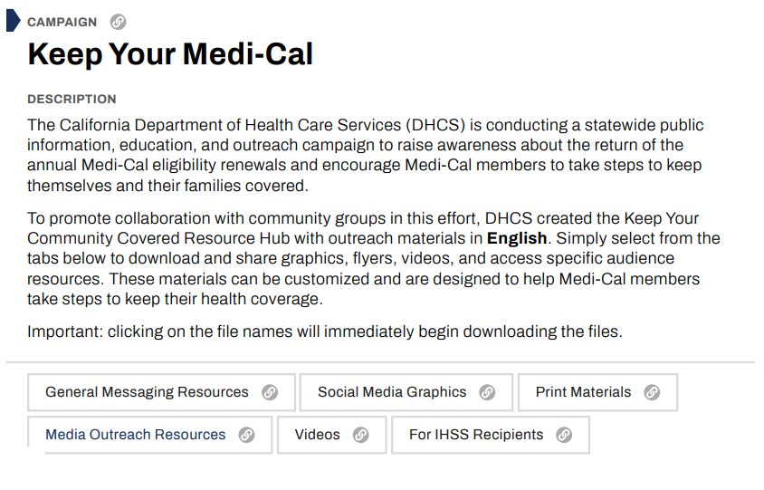
From DHCS Website
Notes:
This is primarily a resource slide
This is from the DHCS website and is available for your organization to pull assets and resources and materials from to help with outreach and education

Slide 21
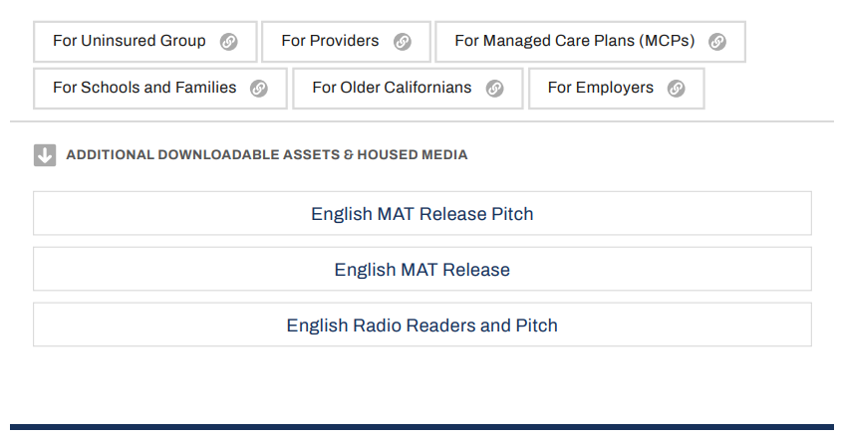
From DHCS Website
Notes:
Looking at the website materials, they have materials by provider type and populations of focus

