Slide 1
Homeless Engagement and Response Team (HEART)
Department of Health Services, Behavioral Health Services (BHS)

Slide 2
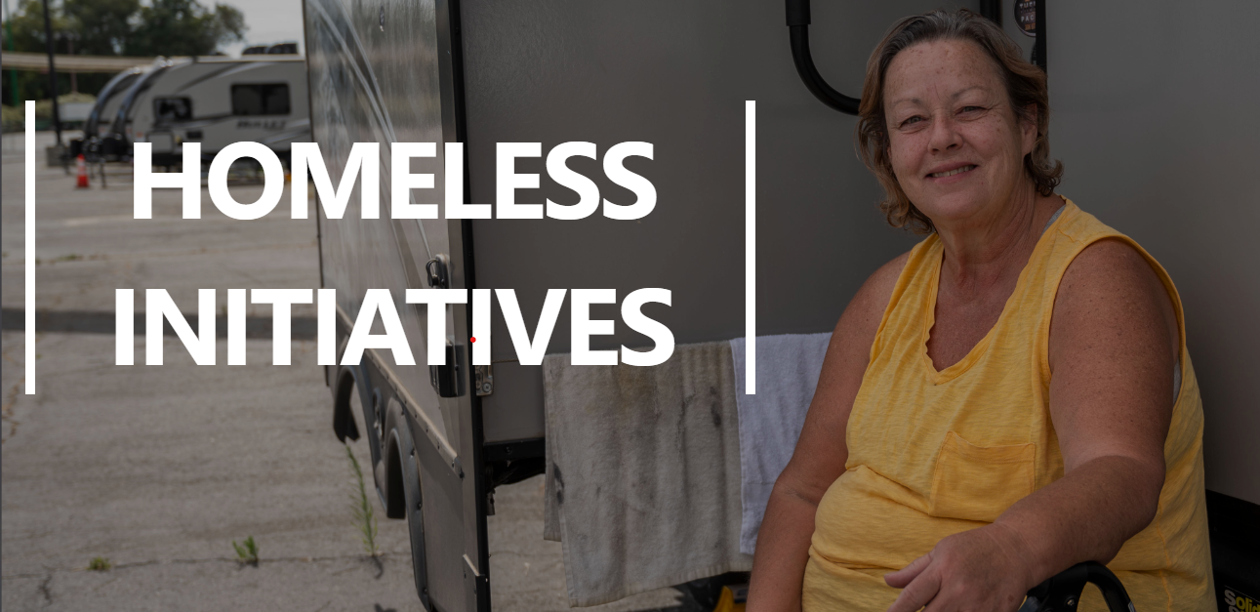
Background
In the 2021/22 Sacramento County budget, the Board of Supervisors (BOS) committed to enhance and expand the County’s ability to respond to unsheltered homelessness, and specifically to mitigate the human and community impacts of homeless engagements.
The County’s engagement Response Approach (ERA) includes coordination of various resources and approaches that allow diverse responses to engagements throughout the unincorporated County and within the County parkway system.
The overall plan includes on-the-ground teams of County staff and contracted staff to deploy in different ways to meet the various needs of engagements; sanitation and debris removal services; and shelters, including the development of an operation of sanctioned engagement sites.
December 2022 the City and County entered into the Homeless Services Partnership Agreement to provide outreach and Engagement in collaboration to provide service linkages to persons experiencing homelessness.

Slide 3
What is HEART?
Sacramento County Behavioral Health Services HEART provides outreach and engagement at the local shelters and in encampments located throughout Sacramento County
HEART coordinates with Sacramento County's Department of Homeless Services and Housing, Department of Human Assistance, and Sacramento City's Department of Community Response to help make more successful placements into shelter/permanent housing and to better connect individuals to necessary services and supports, including health and behavioral healthcare.
​​Staffed with Counselors and Peers, HEART uses a phased approach to help encampment and shelter residents link to needed behavioral health services and support.
Through the initial phase where we develop rapport and trust over time.
The timeline for these phases can be weeks or years.
The team's ultimate goal is to reach linkage phase so that encampment and shelter residents will consent to and can obtain the behavioral services they need.
If you are calling to refer someone else experiencing homelessness, please complete the HEART Referral form. Send a secured email to BHS-HEARTReferrals@saccounty.gov​ with 1) your name, 2) phone number, and 3) a brief message with what services you are seeking.​​Or Call (916) 875-1720.

Slide 4
HEART Purpose and Values
Mental Health First
Shelter/permanent housing as significant secondary priority
Meaningful relationships with partners who have a housing first model
Recovery Oriented
Person-centered, collaborative, strengths based
“Whatever it Takes” mentality
Creative thinking and innovative approaches to service
Equity of access to services
Reduce barriers by bringing services to the client

Slide 5
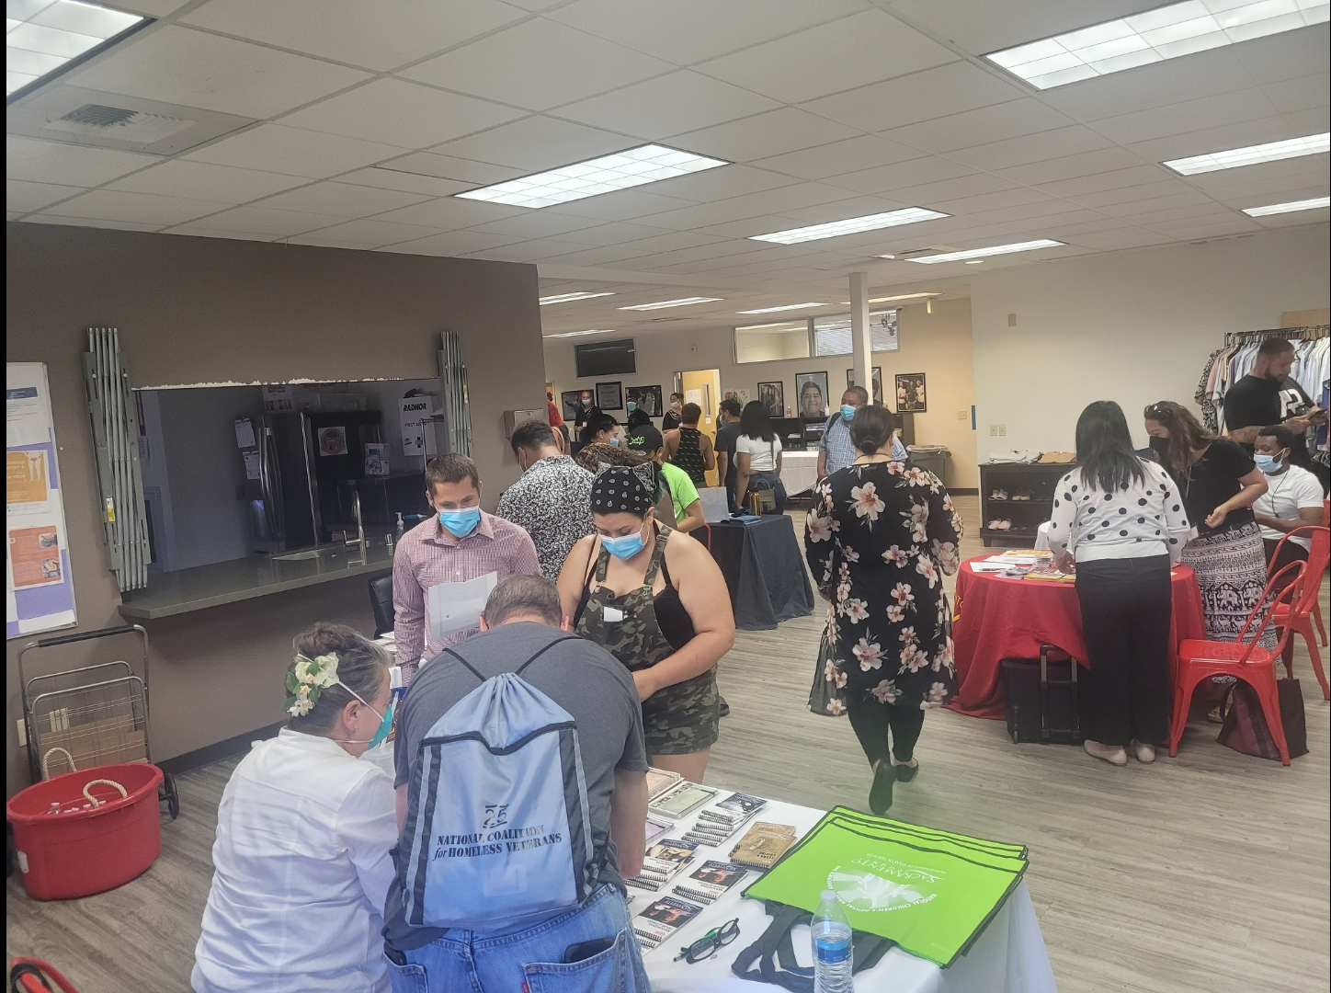
HEART Team
12 Mental Health Counselors
Engage and build rapport/trust within the identified engagements/shelters on an ongoing basis.
Conduct clinical assessments to determine need for further mental health or substance use prevention and treatment and at what level of service.
Admit and discharging client to programs.
Provide crisis intervention as appropriate.
Coordinate with County Department of Human Assistance (DHA) and the city Department of Community Response (DCR) as appropriate for benefits acquisition, housing, shelters, medical care, etc.
Provide psycho-education regarding symptoms, symptom management and treatment options.
Coordinate with mental health providers, system partners, and community partners.

Slide 6
HEART Team
10 Behavioral Health Peer Specialists
Share personal lived experiences relating to homelessness, housing insecurity and/or behavioral health and recovery services in a variety of settings, including person-to-person, small and large groups, and public presentations.
Provide information, education, training and technical assistance on consumer and family member perspective for behavioral health system providers and partners.
Support client and family involvement in services through client-centered engagement.
Participate in countywide regional outreach activities related to Behavioral Health services.
Support clients prior to and during appointments, with the goal of increasing the client’s engagement with service providers and decreasing the stress and anxiety of these appointments.

Slide 7
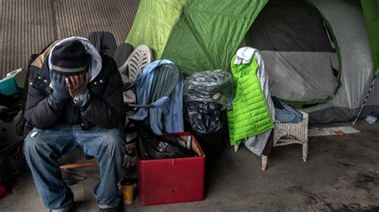
HEART Services
Out in the field to serve the unhoused population by providing linkage to Sacramento County mental health services and Substance Use Prevention and Treatment (SUPT) services to individuals that are interested and eligible.
Our team will also be networking and coordinating with other organizations to assist in bringing various services and resources to the unhoused populations; i.e. medical attention and pet health.
Our goal is to reduce barriers to treatment by bringing these services to the places these individuals call home.

Slide 8
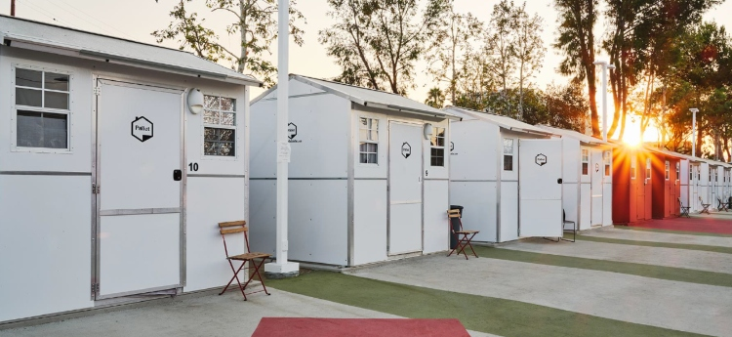
HEART Collaboration
Sacramento County Department of Human Assistance
Sacramento County department of Homeless services and housing
City of Sacramento Department of Community Response
Sacramento Covered
Sacramento Steps Forward
Local jurisdictions and Community Based Organizations (CBO’s)

Slide 9
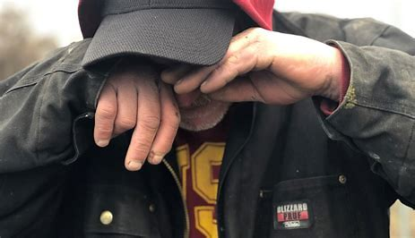
HEART Collaboration
CORE Programs
Adult Outpatient Services Transformation:
Community Outreach Recovery Empowerment (CORE) Program
Sacramento County is transforming the Wellness and Recovery Center, Regional Support Team, Guest House, and TCORE Programs into the new Community Outreach Recovery Empowerment (CORE) Program.
Designed by You
feedback and input gathered from consumers, family members of consumers, direct service staff as well as various community stakeholders.
We'll Meet You There
CORE provides services at 11 sites throughout Sacramento County, each with a co-located peer run community wellness center. These centers will be open to all adult community members. In addition to these sites, services are delivered in the community, wherever requested.
Recovery Happens
Services are strength-based, recovery focused, and flexible. As your needs change, your level of treatment intensity can be adjusted.
Latest updates available at Adult Outpatient Services Transformation: Community Outreach Recovery Empowerment (CORE) Program (saccounty.gov)

Slide 10
CORE Site | Outpatient Program | Community Wellness Center​
1. El Hogar CORE Mariposa 600 Bercut Dr, Sacramento, CA 95811 Phone: 916-440-1500/ Fax: 916-440-1514 | Open | Open Mariposa Group Calendar: Click Here​
2. Turning Point CORE Rosin 3810 Rosin Ct, Suite 170, Sacramento. CA 95834 Phone: 916-567-4222/ Fax: 916-567-4220 | Open | Open Rosin Group Calendar and Catalog: Click Here​
3. Turning Point CORE Madison 3628 Madison Ave, Suite 6, North Highlands, CA 95660 Phone: 916-388-3231/ Fax: 916-388-3232 | Open | Open Madison Group Calendar and Catalog: Clic​k Here​
4. El Hogar CORE Marigold​ Outpatient Program: 8421 Auburn Blvd, Suite 164, Citrus Heights, CA 95610 Community Wellness Center: 8421 Auburn Blvd, Suite 162, Citrus Heights, CA 95610​ Phone: 916-441-3819/ Fax: 916-441-6377​ | Open | Open Marigold Group Calendar: Click Here​
5. Hope Cooperative CORE Marconi 3737 Marconi Ave, Sacramento, CA 95821 Phone: 916-480-1801/ Fax: 916-480-1809 | Open | Open Marconi Group Calendar: Click Here​
6. Hope Cooperative CORE Howe 6a Temp. Site: 3727 Marconi, Sacramento, CA 95821 Phone: 916-485-6500/ Fax: 916-485-6814 6b Future Site: 650 Howe Ave Bldg. 300, Sacramento, CA 95825. Individuals opened to the temp. site will be notified by the provider as soon as the future site is ready. | Open | Not available at temp. site
7. BACS CORE Sycamore Outpatient Program: 9343 Tech Center, Suite 175, Sacramento, CA 95826 Community Wellness Center: 9333 Tech Center Dr, Suite 100, Sacramento, CA 95826 Phone: 916-379-7964/ Fax: 916-379-7964 | Open | Open Sycamore Group Calendar: Click Here
8. BACS CORE Cedar 4600 47th Ave, Suite 111, Sacramento, CA 95824 Phone: 916-318-0141/ Fax: 916-318-0141 | Open | Open​ Cedar Group Calendar: Click Here​
9. Turning Point CORE Elk Grove 9340 E. Stockton Blvd, Elk Grove, CA 95624​ | ​Opening earl​y 2023* | ​Open​
​10. BACS CORE Willow 7171 Bowling Dr, Suite 300, Sacramento, CA 95823 | Opening early 2023* | ​Opening early 2023​*​
11. Hope Cooperative CORE X Street 1400 X Street, Sacramento, CA 95818​​ | ​Opening summer 2023* | ​Opening summer 2023*

Slide 11
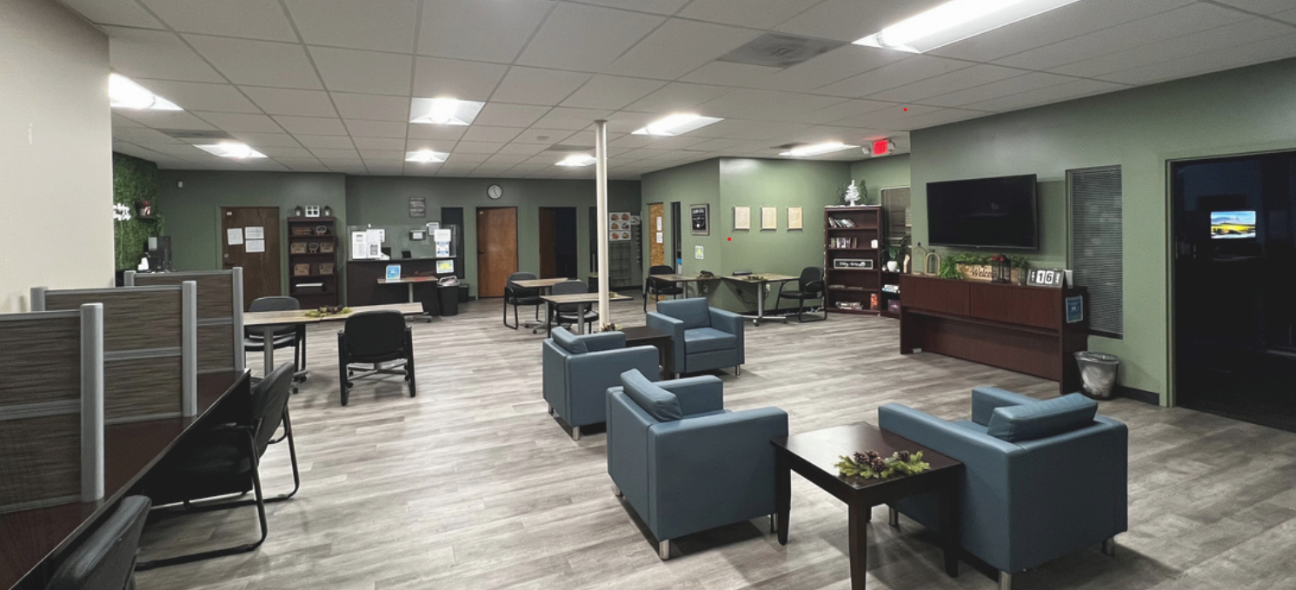
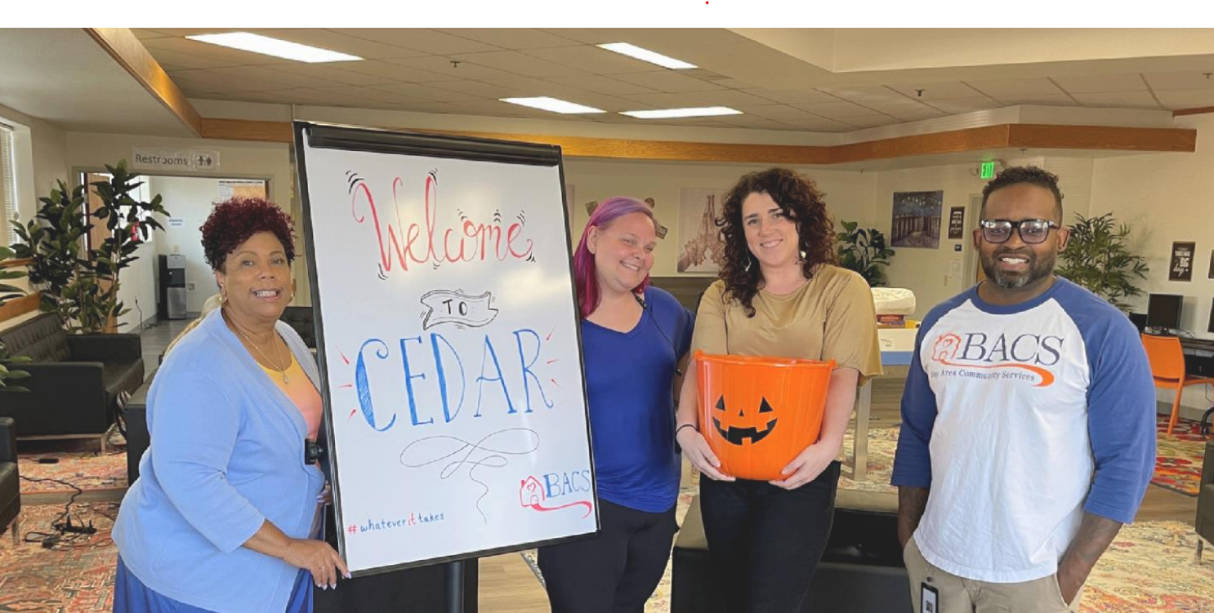
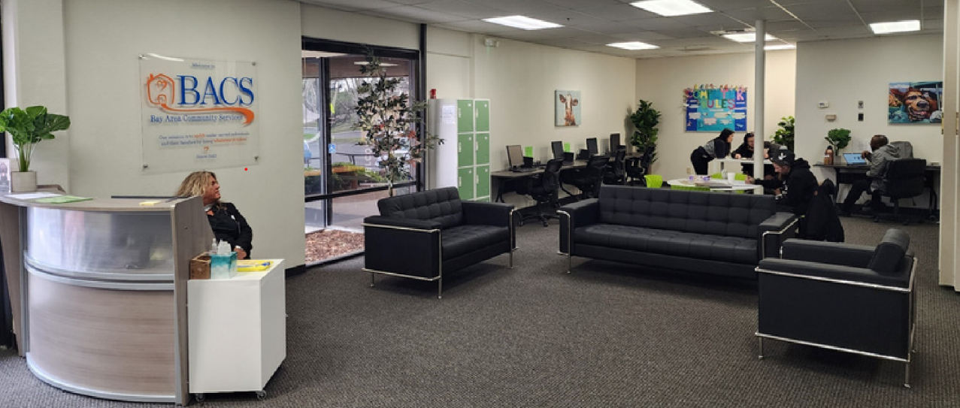
CORE Community Wellness Center Locations
Visit upcoming Open Houses! Info at: https://dhs.saccounty.gov/BHS/Pages/Adult-Outpatient-Services-Transformation.aspx

Slide 12
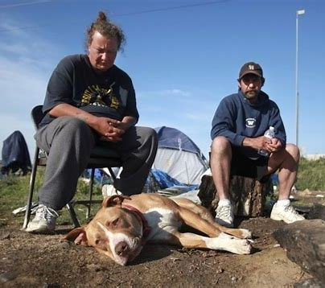
HEART Collaboration
BHS Full Service Partnerships (FSPs)
Collaborate closely with homeless outreach teams. This includes:
Support the rapport building process by participating in a joint outreach session with homeless outreach teams in clients’ homes, to be initially set up by the homeless outreach teams.
Engage with and provide behavioral health services to individuals experiencing homeless in the places they call home, e.g. engagements, shelters, cars.
Support linkages by providing community based services, transport to office based services and training for clients living homeless to get to their own appointments.

Slide 13
engagement Services Team (EST)
Complete intake/assessment for initial site deployment
connections for resources like Service mainstream benefits and County shelter/resource connections.
Short-term case management and problem-solving services for linkages to services and resources.
Coordinate with county agencies serving the mutual customer, when necessary, to deliver services.
warm hand off support to shelter and/or other housing programs.

Slide 14
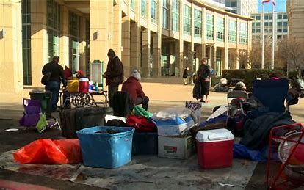
City County Partnership
Agreement Term 5- Year, with annual updates
Identifies roles, responsibilities, and key staff/departments from City and County
Addresses key provisions of the Emergency Shelter and Enforcement Act of 2022 (Measure O)
Demonstrates shared commitment to the Local Homeless Action Plan and Coordinated Access System
Commitment to 10 Outreach Teams within City jurisdiction

Slide 15
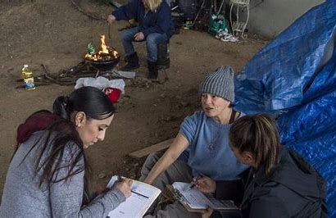
How BHS helps People Experiencing Homelessness
Medication Support
Benefits Support (GA/SSI/SSD/Medi-Cal)
Homelessness prevention
Referrals to programs and resources for health and recovery
Co-Occurring Disorder Groups/Supports
Case Management
Accessing education
Supports with vocational resources and job readiness
Psycho-Social Rehabilitation
Community Integration
Individual Therapy (children’s and Higher Intensity Programs)
Housing Search (Higher Intensity Programs)
Rapid ReHousing
Supportive Housing (Higher Intensity Programs)
Help remove housing barriers

Slide 16
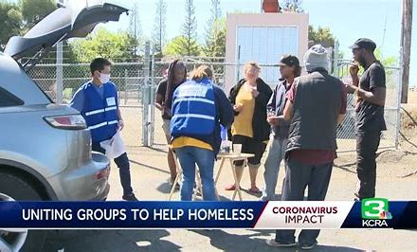
Walk In & Connect to Services
at local
CORE Community Wellness Center

